Slide 1
An analysis of Athena Swan as a policy- scoring scheme
Dr John Armstrong,
KCL Department of Mathematics
Professor Alice Sullivan,
UCL Social Research Institute
University of Lancaster 8th February 2023

Slide 2
Structure
Introduction to Athena Swan
Quantitative data analysis
Policy analysis
Notes:
Presentation covers 2 papers

Slide 3

What is Athena Swan?
The Athena Swan Charter is a framework which is used across the globe to support and transform gender equality within higher education (HE) and research. Established in 2005 to encourage and recognise commitment to advancing the careers of women in science, technology, engineering, maths and medicine (STEMM) employment, the Charter is now being used across the globe to address gender equality more broadly, and not just barriers to progression that affect women.
Advance HE members can apply for institutional and departmental Athena Swan awards recognising their gender equality efforts.

Slide 4
A Policy Scoring Scheme
Institutions write a policy document on gender equality
  Document follows a template determined by Advance HE
  Institution receives guidance from Advance HE + wider community
  Documents judged by panel of experts (not Advance HE)
  Can receive No award/Bronze/Silver/Gold
Not a “benchmarking scheme”
  Subjective assessment
  No requirement to publish data
  No central repository of applications
  Not required to publish failed applications
Similar schemes: Stonewall Workplace Equality Index, Race Equality Charter, Gender Action programme in schools.

Slide 5
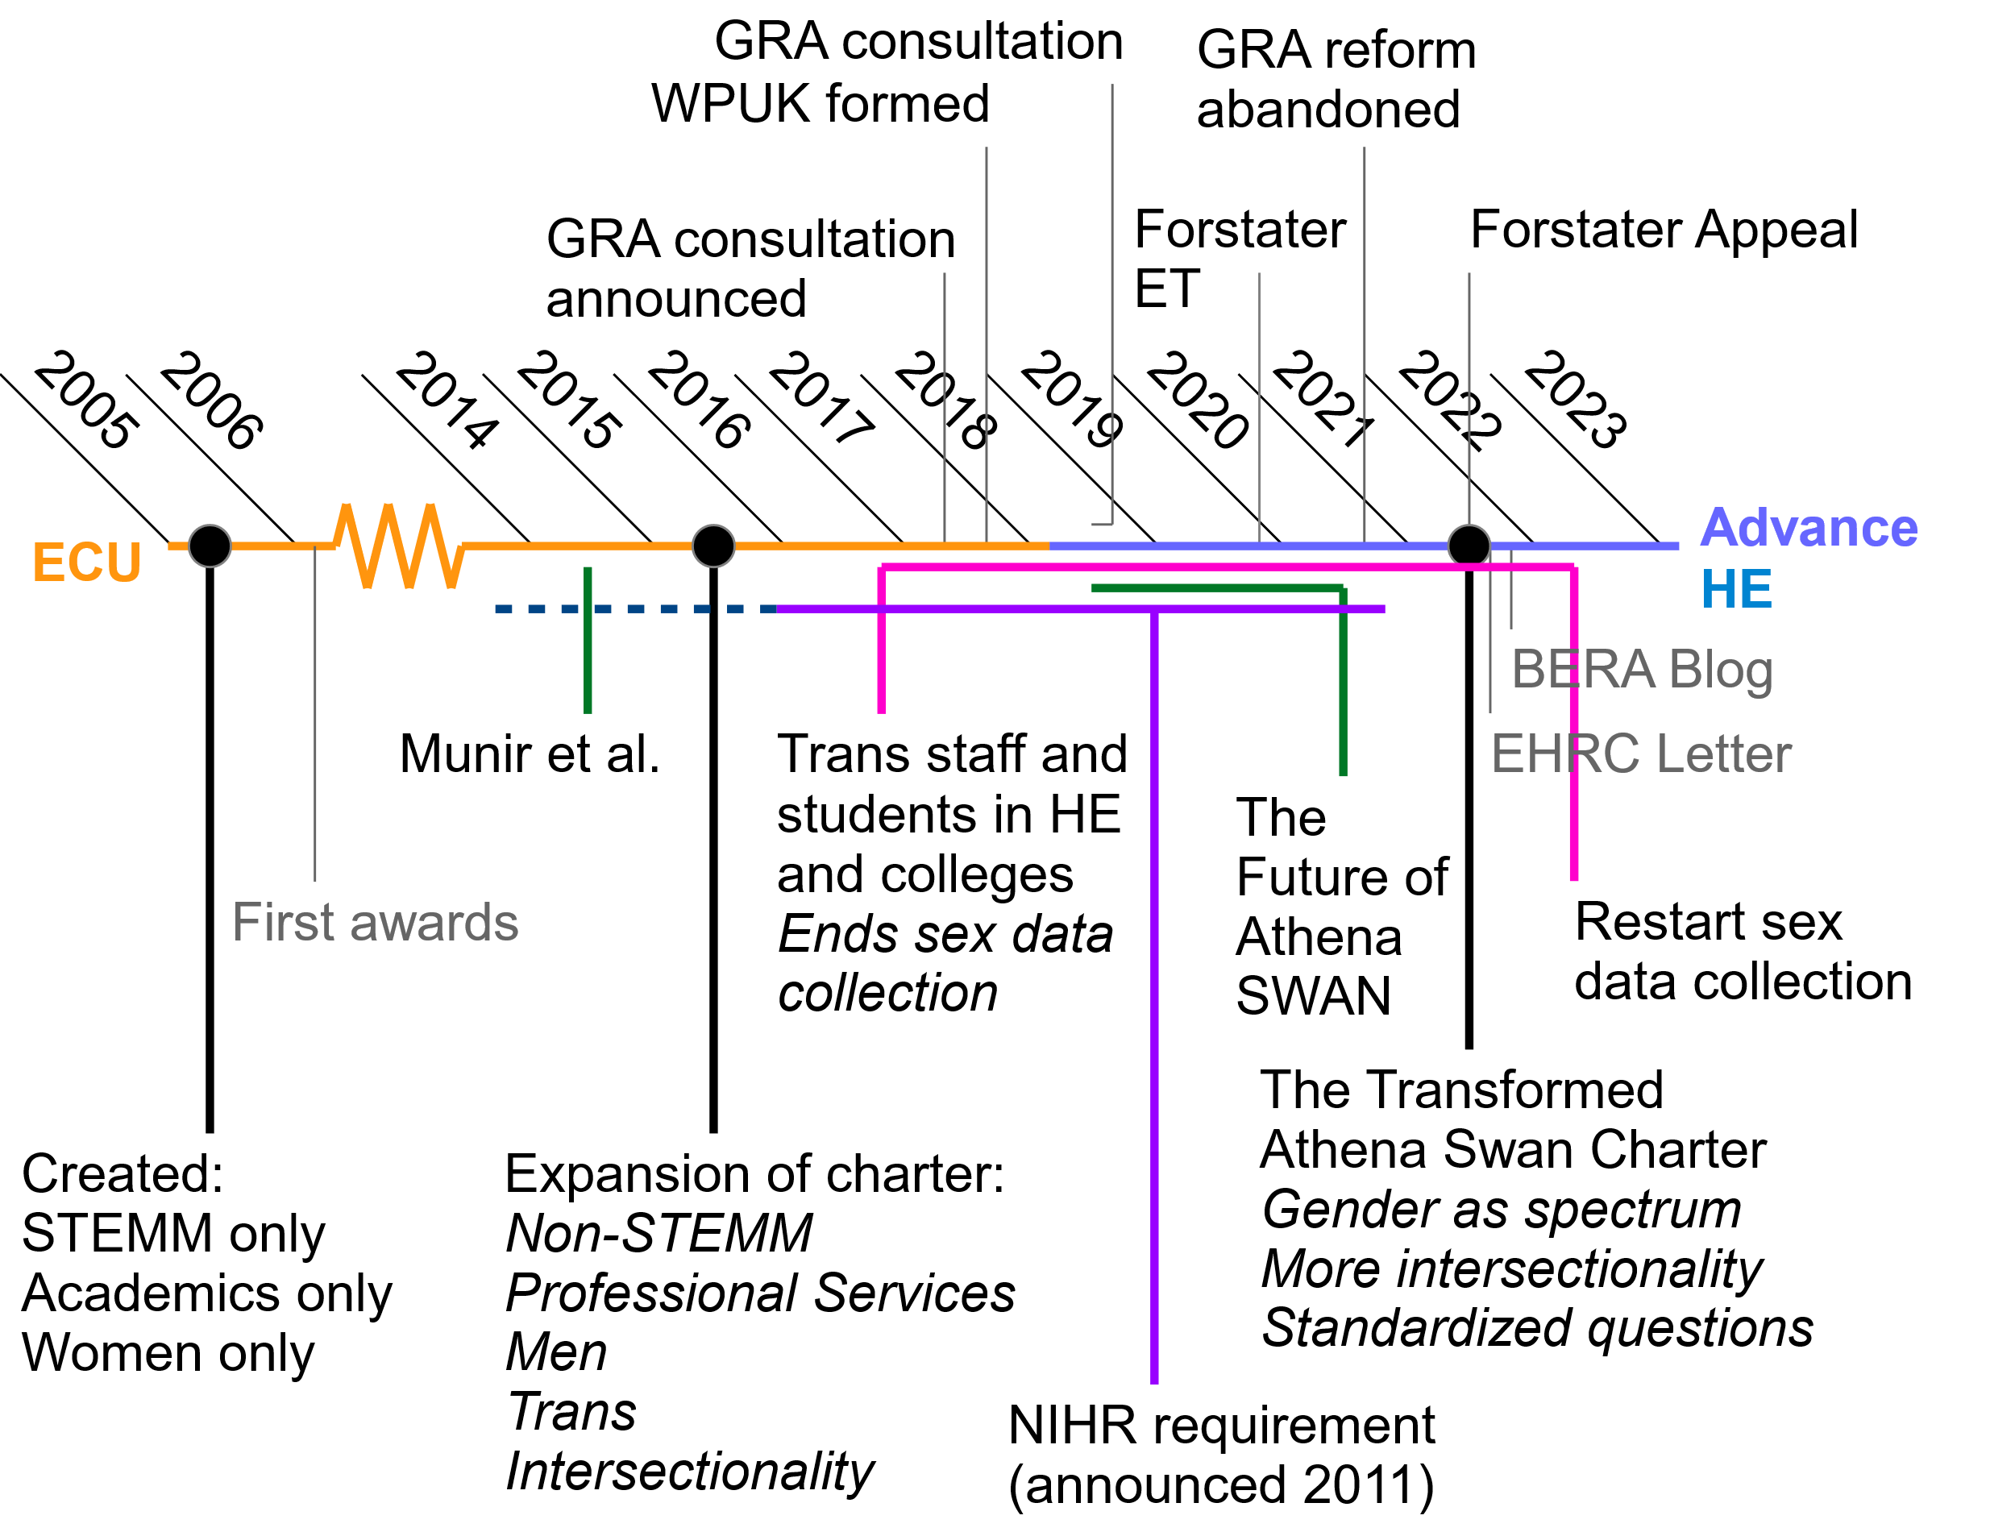

Slide 6
Literature review
Good points
  ♀ Raises the profile of gender equality
  🙂 Higher ratings of gender equality efforts in staff surveys
  ➕ Positive initiatives
Bad points
  ☑️ Resource intensive, falls on female academics, box-ticking
  🤔Perverse incentives and tokenism
  ∩ Neglect of race
Neither good nor bad
  📈 Sector wide improvements in female representation that cannot be attributed to Athena Swan
  😲Institutional improvements that can be attributed to Athena Swan
Sources
Munir et al, 2014 ♀🙂
Caffrey et al, 2016 ♀➕☑️
Ovseiko et al, 2017 ➕☑️🤔
Gregory Smith, 2018 📈
Tzanakou and Pearce, 2019 ♀🤔
The Future of Athena Swan, 2020 ♀☑️∩
Ovseiko et al 2020 📈
Xiao et al 2020 😲
Bhopal and Henderson 2021 ∩

Slide 7
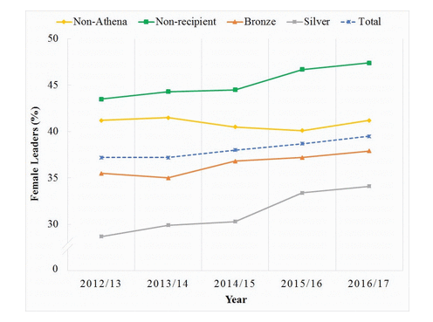
Xiao et al (2020)
Did not emphasize fact silver is worse than bronze etc. Focused on rate of improvement.
Let: p = proportion women in leadership roles
Model:
p ~ year + status + year x status
Statistically significant interaction

Slide 8
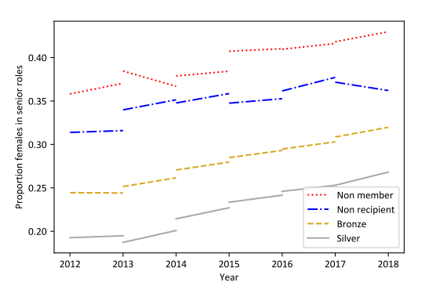
Our analysis
Models we tried
Δp ~ c₁ (p-0.5) + c₂
Where c₁ and c₂ may or may not depend on Athena Swan status
We found best model was c₁ independent of status, c₂=0
Interpretation:
Sector is moving to gender equality
No statistically significant impact of Athena Swan

Slide 9
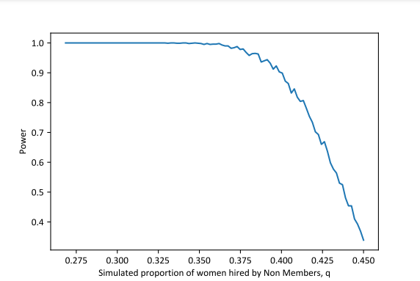
Power analysis
Scenario tested:
Suppose with prob 5% that a staff member is replaced in a given year
There is a 50% chance of Athena Swan members replacing them with a woman
There is a probability q of a non-member replacing them with a woman
What proportion of the time would our analysis notice the effect of Athena Swan?

Slide 10
Conclusions from the data
  “the link between Athena SWAN and research funding is a controversial issue particularly because Athena SWAN is not a standard-based award” (Munir et al 2014)
  We would go further and argue that the awards are likely to mislead.
  There is no evidence that Athena SWAN leads to improved female representation in senior roles.
  In some reasonable models, there would be sufficient statistical power to detect the impact of Athena Swan

Slide 11
Policy Analysis
How does Athena Swan influence HEIs? And how has Athena Swan itself been influenced?
We reviewed the Athena Swan guidance provided on its website, the historical development of this guidance.
We looked at four departmental Athena Swan submissions and two institutional action plans and held one interview with staff at Advance HE.
Notes:
UCL Bartlett
Oxford History
Imperial maths
Leeds medicine

Slide 12
Key Issues
Awards are misleading
Data collection on sex dropped from 2016-2022
Policy capture
Groupthink
Compromising academic freedom
Does not promote rational prioritisation
Sexual harassment

Slide 13

Misleading Awards
Silver award holders have fewer women in senior positions than bronze award holders and institutions without awards.
Athena Swan rewards plans for improvement rather than outcomes.
E.g. Imperial maths has AS Silver, despite only 6% women profs.
The fact that AS is not a standard based award is widely misunderstood.
Decision to decree only orgs with silver could receive NIHR funding (2011) meant orgs with lower f representation rewarded.

Slide 14

Data Collection on Sex
From 2016-2021, Advance HE told HEIs to collect data on ‘gender’ rather than sex.
“Advance HE recommends asking a question about gender rather than asking a question about sex. This ensures equality efforts are… inclusive of a diverse range of gender identities.” (Advance HE, 2021d)

Slide 15
How would you describe your gender?
Man
Non-binary
Woman
In another way (specify, if you wish)
Prefer not to say

Slide 16
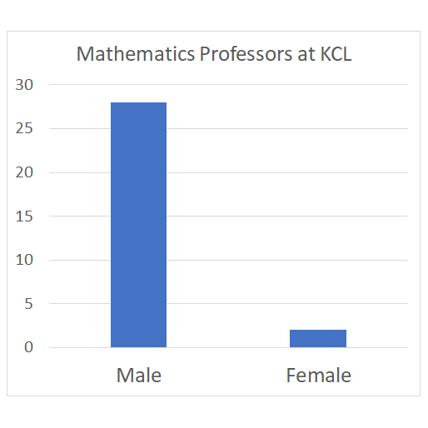
Are the numbers too small to make a difference?
Example
A maths department has 2 female professors
1 professor identifying differently could change the statistics by 50% overnight.

Slide 17
Public Sector Equality Duty
HEIs have a legal duty to monitor equalities according to sex.
BERA blog 2021 “Has Athena Swan Lost Its Way?”
Advance HE posted new guidance asking sex and Gender Identity as separate questions (April 2022).

Slide 18



Policy capture
Power of gold stars to influence management policy
Universities lose sight of their own goals by outsourcing policy
A few activists have been able to disproportionately influence AS policy
Sally Hines “Gender as a Spectrum” working group: “recognition of sex and gender as existing on a spectrum” is a potential first step to a vision where all staff and students receive gender identity training that would “entail a discursive shift from anti-trans rhetoric as ‘opinion’
Lack of real consultation, transparency and clarity in reaching conclusion that ‘gender is a spectrum’.
The subversion of Athena Swan. The Critic.

Slide 19
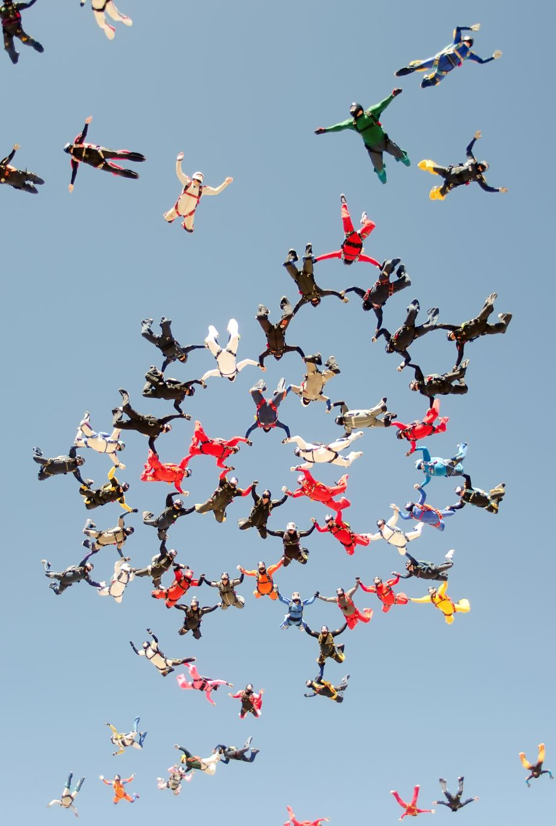
Groupthink
Award structure and external review make going against Advance HE recommendations and sector norms high risk.
E.g. overreliance on Unconscious Bias Training as a panacea in applications we examined. This may distract from structural and practical problems.

Slide 20

Academic Freedom
Curriculum: EDI driven curriculum change, e.g. asking students to vet reading lists (Oxford).
Research: Athena Swan principles require a commitment to: “fostering collective understanding that individuals have the right to determine their own gender identity.” (Advance HE, 2021e)
Embedding view that it is ‘more inclusive’ not to collect data on sex (and that doing so is transphobic): consequences for ethics committees.

Slide 21
Failures of prioritisation
‘There is a lot of sort of topsy-turvy stuff like the school of nursing for example, they’re very, very heavily female biased, so what are they trying to achieve? I mean equality would mean taking on more men, so there are weirdnesses about the whole SWAN thing, and it is quite hard to get your head around it.’ (Female Prof cited in Munir et al)
Universities must balance the competing interests of diverse groups. This is enshrined in law as the public sector equality duty to foster good relations between people who share a protected characteristic and those who do not.

Slide 22

‘Intersectionality’
“increased inclusion of intersectionality in Athena SWAN actions.”
(LSE 2019 Action Plan, measure of success)
Distraction from race equality
Intersectionality doesn’t deal with main effects.
Introduction of Race equality Charter may simply replicate problems of AS, separating consideration of each characteristic.

Slide 23
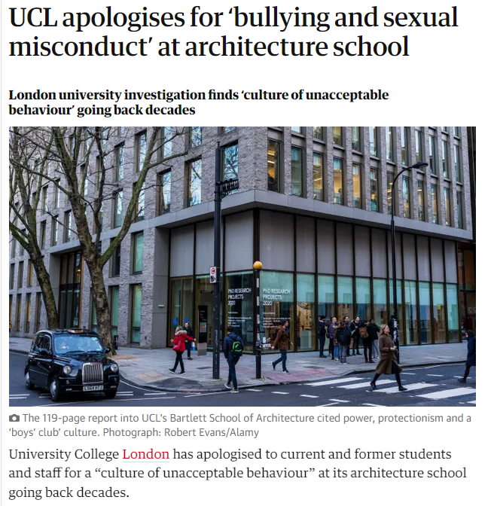
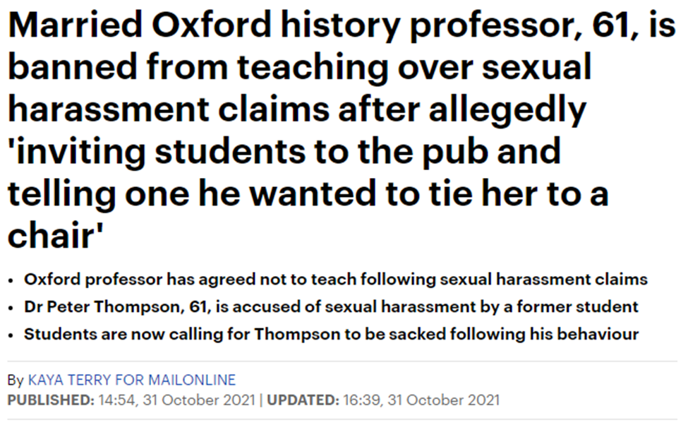
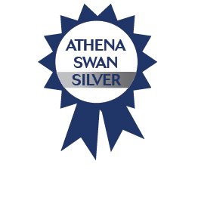
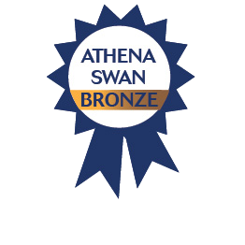
Sexual harassment
Notes:
Bartlett received Silver shortly after this story broke. AS submission did not raise these concerns.
The History Faculty of Oxford (Bronze award) state on their website that “In lieu of our usual Athena Swan activity, we are focusing on the Faculty's harassment and complaints policy” (University of Oxford, 2022), suggesting that they did not find Athena Swan sufficiently helpful to wish to continue with the activity. However, their Athena Swan submission did prominently highlight the existence of problems in their effective handling of complaints of harassment.

Slide 24

Conclusions and policy recommendations
We’ve identified a number of problems with Athena Swan, which it shares with other policy points-scoring schemes.
However, the original vision of Athena Swan to encourage the monitoring of equalities data should not be lost.
A lighter-touch model would be simply to mandate data harmonization and public data sharing of university equalities data.

